Slide 1
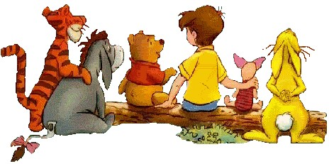
UNIT 1: Back to school.
Friends
A1,2,4

Slide 2
Warm up
- How is your summer vacation?
What do you often do during the summer vacation ?
Do you want to meet your teachers and friends after the vacation ?
What do you say when you meet them again ?

Slide 3
I. VOCABULARY
- classmate (n):
bạn cùng lớp
- So am I =
Me, too.
Tôi cũng vậy.
- still (adv) :
vẫn
- unhappy (adj) :
không vui
- different (adj) :
không giống, khác
- lots of = a lot of :
nhiều
- uncle (n):
cậu, chú, bác
- aunt (n) :
cô, dì, thím, mợ
- miss (v) :
nhớ, nhớ nhung

Slide 4
Wordsquares
Find out 10 words in this box.
School
Old
Big
New
Parent
Live
Aunt
Student
Friend
happy
S | C | H | O | O | L | D
T | T | B | I | G | H | N
U | N | C | L | E | A | E
D | U | J | I | T | P | I
E | A | S | V | N | P | R
N | E | W | E | U | Y | F
T | N | E | R | A | P | Q
S
C
O
B
H
L
U
A
N
F
P

Slide 5
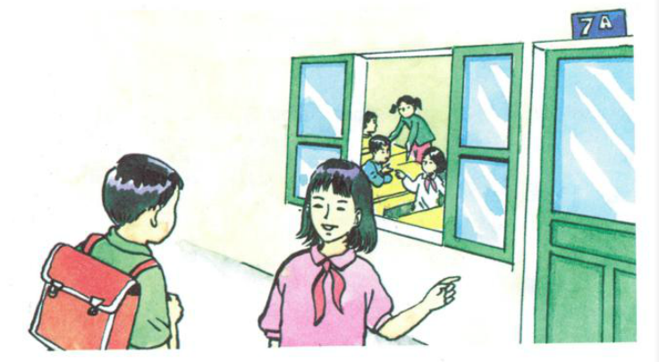
A1.Listen:
Then practice with a partner.
b) Hoa: Good morning. My name’s Hoa.
Nam: Nice to meet you, Hoa.
My name’s Nam.
Are you a new student?
Hoa: Yes. I’m in class 7A.
Nam: Oh, so am I.
Ba: Hello, Nga
Nga: Hi, Ba. Nice to see you
again.
Ba: Nice to see you, too.
Nga: This is our new classmate.
Her name’s Hoa.
Ba: Nice to meet you, Hoa.
Hoa: Nice to meet you, too.

Slide 6
 Answer the questions:
a. What is the new girl’s name?
b. What class is she in?
c. Who is also in class 7A?
Her name is Hoa.
She’s in class 7A.
Nam is also in class 7A.

Slide 7
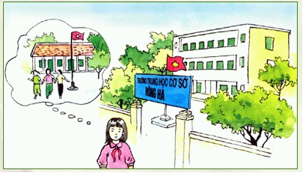
A2.

Slide 8
I. New words :
Different ( Adj.) + from:
khác nhau
Happy ( Adj.) #
Unhappy
(To) miss :
Feel sad that a person or thing is not present

Slide 9
Hoa is a new student in class 7A. She is from Hue and her parents still live there. She lives with her uncle and aunt in Ha Noi.
Hoa has lots of friends in Hue. But she doesn’t have any friends in Ha Noi. Many things are different. Her new school is bigger than her old school. Her new school has a lot of students. Her old school doesn’t have many students.
Hoa is unhappy. She misses her parents and her friends.

Slide 10
II. Grammar:  Singular:
1/
a +
Consonant (phụ âm)
2/
an +
Vowel Sound (nguyên âm)
 Plural:
1/
many +
Plural N (danh từ số nhiều)
2/
any +
Plural N/ Uncountable N (dùng cho câu phủ định và nghi vấn, danh từ số nhiều/ danh từ không đếm được)
3/
A lot of
Lots of
+
Plural N/ Uncountable N

Slide 11
COMPARATIVE ADJECTIVES TÍNH TỪ SO SÁNH HƠN
I - Tính từ ngắn và tính từ dài
1. Tính từ ngắn - Tính từ có một âm tiết Ex: short, thin, big, smart
Tính từ có hai âm tiết nhưng kết thúc bằng –y, –le,–ow, –er, và –et
Ex : happy, gentle, narrow, clever, quiet
2. Tính từ dài
- Các tính từ hai âm tiết không kết thúc bằng những đuôi nêu trong phần tính từ ngắn Ex: perfect, childish, nervous
- Các tính từ có từ ba âm tiết trở lên Ex: beautiful (ba âm tiết), intelligent (bốn âm tiết), satisfactory (năm âm tiết)

Slide 12
II - So sánh hơn của tính từ ngắn: adj + -er + (than)
Ex: Bikes are slower than cars.
*Quy tắc thêm –er vào sau tính từ ngắn trong so sánh hơn - Phần lớn các tính từ ngắn: thêm –er (fast – faster) - Tính từ kết thúc bằng –y: bỏ –y, và thêm –ier (happy – happier) - Tính từ kết thúc bằng –e: thêm –r (simple – simpler) - Tính từ kết thúc bằng một nguyên âm và một phụ âm: gấp đôi phụ âm cuối rồi sau đó mới thêm –er (thin – thinner)
III - So sánh hơn của tính từ dài: more + adj + (than)
Ex: - A lion is more dangerous than an elephant. - This doll is more expensive than that doll.
* Một số tính từ đặc biệt
good - better bad - worse many, much - more little - less far - farther, further

Slide 13
 Answer True/False sentences:
a. Hoa’s parents live in Ha Noi.
b. She has more friends in Ha Noi than in Hue.
c. There are a lot of students in her old school.
d. She misses her friends in Hue.
e.. Hoa is not happy in Ha Noi.

Slide 14
 Answer True/False sentences:
a. Hoa’s parents live in Ha Noi.
b. She has more friends in Ha Noi than in Hue.
c. There are a lot of students in her old school.
d. She misses her friends in Hue.
e.. Hoa is not happy in Ha Noi.
F
F
F
T
T

Slide 15
 Answer the questions:
a/ Where is Hoa from?
b/ Who is she staying with?
c/ Does she have a lot of friends in Ha Noi?
d/ How is her new school different from her old school?
e/ Why is Hoa unhappy?

Slide 16
a) Where is Hoa from?
She is from Hue.
b) Who is she staying with?
She is staying with her uncle and aunt.
c) Does she haves lots of friends in Ha Noi?
No, she doesn’t.

Slide 17
d) How is her new school different from her old school?
 Her new school is bigger than her old school.
 Her new school has a lot of students.
e) Why is Hoa unhappy?
Because she misses her parents and her friends.

Slide 18
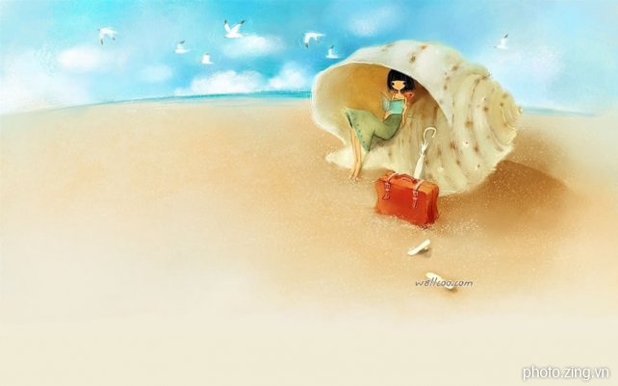
Unit1: Back to school A2
III- Answer the questions
a) Where is Hoa from?
Hoa is from Hue.
b) Who is she staying with?
She is staying with her uncle and aunt.
c) Does she have a lot of friends in Ha Noi?
No, she doesn’t have any friends in Ha Noi.
d) How is her new school different from her old school?
Her new school is bigger than her old school.
e) Why is Hoa unhappy?
Because she misses her parents and her friends.

Slide 19
A4.Listen and complete the dialogue:
a. Mr Tan: Hello Lien. ………………………… ?
Miss Lien: ………………………., thank you.
………………………….., Tan?
Mr Tan: …………………., but I’m very busy.
Miss Lien: ………………. .
b. Nam: Good afternoon, Nga. ……………………?
Nga: …….. ,thanks. ……………………… , Nam ?
Nam: ………………,thanks.
Nga: I’m going to the lunch room.
Nam: Yes, …………. .

Slide 20
Matching:
Pretty good.
How is every thing?
Nice to see you.
So am I./ Me, too.
Not bad.
Just fine.
Không tốt lắm
Tôi cũng vậy.
Khá tốt.
Bình thường thôi.
Mọi việc như thế nào?
Rất vui khi gặp bạn.

Slide 21
A4.Listen and complete the dialogue:
a. Mr Tan: Hello Lien. ………………………… ?
Miss Lien: ………………………., thank you.
………………………….., Tan?
Mr Tan: …………………., but I’m very busy.
Miss Lien: ………………. .
b. Nam: Good afternoon, Nga. ……………………?
Nga: …….. ,thanks. ……………………… , Nam ?
Nam: ………………,thanks.
Nga: I’m going to the lunch room.
Nam: Yes, …………. .

Slide 22
A4.Listen and complete the dialogue:
How are you
a. Mr Tan: Hello Lien. ………………………… ?
Miss Lien: ………………………., thank you.
………………………….., Tan?
Mr Tan: …………………., but I’m very busy.
Miss Lien: ………………. .
Pretty good
How about you
Not bad
Me, too

Slide 23
b, Nam: Good afternoon, Nga.
……………………………………..?
Nga: ………, thanks. ……………………………...., Nam ?
Nam: …………………,thanks.
Nga: I’m going to the lunch room.
Nam: Yes, ……………… .
How is everything
Ok
How are you today
Just fine
so am I

Slide 24
Homework
Learn the lesson well.
- Prepare: Unit 1: B1,2,4,5

Slide 25
Thanks for your attention.

